Slide 1

Survey on Evaluation Approaches for Open-domain Dialogue Systems
By Ruolan YANG, 2021.3.17

Slide 2
Outline
Introduction
Traditional evaluation approaches
Automatic metrics
Human judgements
Spot The Bot: A Robust and Efﬁcient Framework for the Evaluation of Conversational Dialogue Systems (EMNLP, 2020)
Discussion

Slide 3
Outline
Introduction
Traditional evaluation approaches
Spot The Bot (EMNLP, 2020)
Discussion

Slide 4
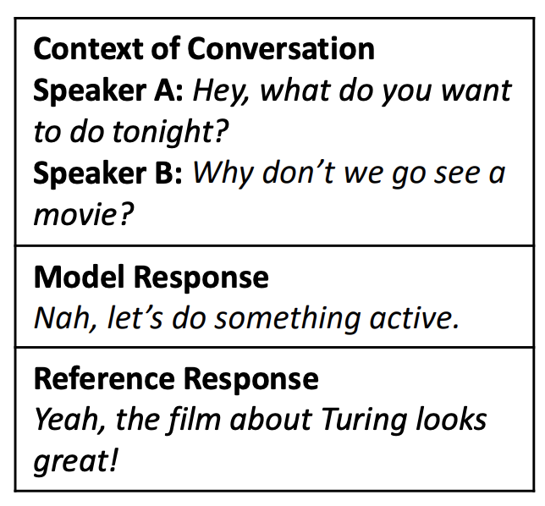
Introduction
Problems:
Open-ended nature
One-to-many relationships
Poor correlation
Expensive human labor
Goal:
Efficient, automatic,
high correlation, inexpensive
Notes:
Evaluation is a long-standing issue in developing conversational dialogue systems. Unlike those task-oriented dialogue systems whose success can be measured in relation to a priori deﬁned ground truth, chatbots do not solve a clearly-deﬁned task, it has an open-ended nature. The major challenge with the evaluation of open-domain dialog systems comes from the one-to-many relationship between the user’s input and plausible responses.
For example, here we can see in this conversation….
The available automatic metrics mostly do not solve this problem but they are still widely used when developing open-domain dialog models because human evaluations are prohibitively expensive to use at the model development stage.
The goal is to…

Slide 5
Outline
Introduction
Traditional evaluation approaches
Spot The Bot (EMNLP, 2020)
Discussion

Slide 6
Traditional Evaluation approaches
Automatic metrics
Word overlap metrics
e.g., BLEU, METEOR, ROUGE, etc.
Embeddings based metrics
e.g., Coherence.
Trained metrics
e.g., ADEM
Notes:
Above all, we first quickly go through these traditional evaluation approaches used for open domain dialogue systems. The BLEU , ROUGE , and METEOR metrics measure the word overlap between the generated responses and the reference ones. This is nearly the same as other natural language generation tasks. Many researchers argue that these metrics are not appropriate for the evaluation of open-domain dialog agents since there are many plausible responses to the same user’s input, while the number of reference responses in a test set is always limited. Thus, neither of the word-overlap-based scores has any correlation to human judgments.
Coherence measures the average word embedding similarity between dialogue context and generated response.Unluckily,..
Trained metrics : Lowe et al. (2017a) present an automatic dialogue evaluation model (ADEM), which uses a recurrent neural network trained to predict appropriateness ratings by human judges. The human ratings were collected via Amazon Mechanical Turk, where the judges were presented with a dialogue context and a candidate response, they rated on appropriateness on a scale from 1 to 5. Based on the ratings, a recurrent neural network was trained to score the model response. As we can see, we need human annotators to provide these annotations in advance.

Slide 7
Traditional Evaluation approaches
Human judgements
Static evaluation
Interactive evaluation
Frequently-used metrics
Quiz: Can you name one of these frequently-used metrics while evaluating dialogue generation systems?
Notes:
We divide traditional human evaluation approaches into two categories. Static evaluation is an ofﬂine procedure where the evaluators never directly interact with the dialogue systems. instead, they are provided with dialogue excerpts. These excerpts are generated by ﬁrst randomly sampling dialogues from a corpus consisting of human-to-human conversations, then having the systems produce responses to the sampled dialogues. The sampled dialogues together with the system responses are provided to human evaluators to assess. Because only the last utterance in these excerpts are generated by the dialogue systems, it is difﬁcult to evaluate sequential aspects about dialogue management.
Unlike static evaluation, interactive evaluation has the same person play the role of both the user (one who interacts with the system) and the evaluator. In this setup, the evaluator has a conversation with the dialogue system and makes the assessment at the end of the conversation. Even though this procedure is more demanding in terms of time and human effort than static evaluation, it allows the evaluator to gain a better sense of the capability of the dialogue system through explicit interaction.
Common metrics :There is high variability in the dimensions of dialogue that previous studies have used for assessing dialogue systems. Generally speaking, these metrics can be grouped to 3 non-overlapping components, which are grammatical capability, turn coherence and response informativeness.

Slide 8
Traditional Evaluation approaches
Human judgements
Static evaluation
Interactive evaluation
Frequently-used metrics
Quiz: Can you name one of these frequently-used metrics while evaluating dialogue generation systems?
Answer: Fluency, Consistency, Readability, Relevance, Appropriateness, Informativeness, Specificity etc.

Slide 9
Outline
Introduction
Traditional evaluation approaches
Spot The Bot (EMNLP, 2020)
Discussion

Slide 10
Spot The Bot: A Robust and Efﬁcient Framework for the Evaluation of Conversational Dialogue Systems (EMNLP, 2020)
Basic observations:
Ability to mimic human behavior
Length of conversation
Overview
A tournament among chatbots
Survival Analysis
Notes:
in the work of this paper, Spot The Bot, the authors have come up with a cost-efficient huamn evaluation framework. Spot The Bot employs a tournament among chatbots to determine which performs the best at mimicking humans'conversational behavior. It works as a multiturn-based evaluation with human judges.
This evaluation framework is based on two observations: First, chatbots are trained on conversations between humans, and thus, it’s reasonable that they should be evaluated regarding their ability to mimic human behavior. Second, the longer a conversation is, the more likely it is that a bot exhibits non-human-like behavior.
To measure the success of each bot, human crowd-workers are shown conversations between two competing bots at a time, mixed with conversations between two humans. The crowdworkers’ task is to determine for each entity in a conversation whether it is a human or a bot (or whether the crowdworker is unsure). The bot that is most frequently annotated as being human wins the tournament.
There are different use cases for Spot The Bot, e.g., when a novel dialogue strategy is to be compared against existing ones or if a set of chatbots is to be ranked in the context of a shared task. On top of returning a ranking, Spot The Bot employs the Survival Analysis, which introduces a time aspect into the evaluation.

Slide 11
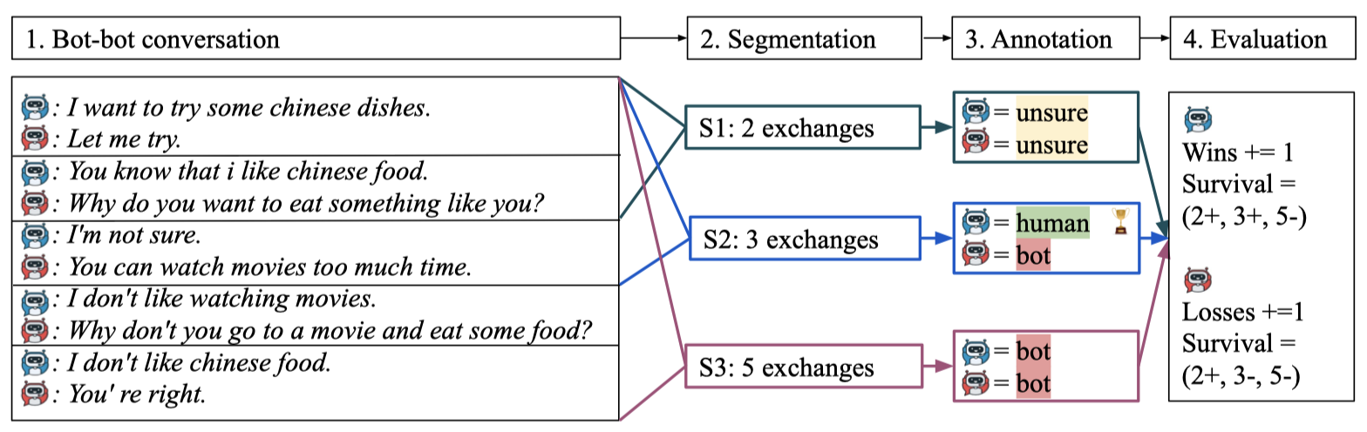
Spot The Bot (EMNLP, 2020)
Overview of Spot The Bot process for one conversation
Notes:
Now we have a look at the overview of this framework for one conversation. Here, we show a bot-bot conversation on the left, which contains 5 exchanges in total.
(Segmentation): The first step is called segmentation. A whole conversation is segmented into different lengths at this stage(e.g., 2,3 and 5 exchanges). A segment is deﬁned as the ﬁrst k exchanges of the dialogue. Thus, an annotator only sees the ﬁrst k exchanges of the conversation. Each segment of the same conversation is rated by a different annotator to avoid that one annotator sees parts of the same conversation multiple times, which would bias the rating.
Annotation: These segments are shown to distinct sets of annotators who judge whether each entity is a bot. As you can see in the figure, the annotators have to decide for each entity in a conversation segment if it is a bot or a human.

Slide 12
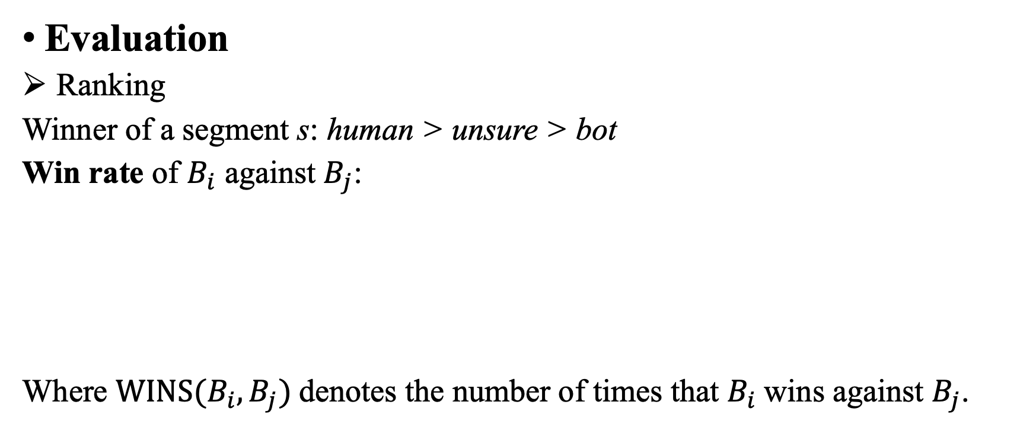
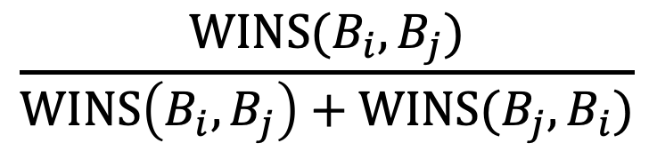
Spot The Bot (EMNLP, 2020)
Evaluation
Ranking
Winner of a segment s: human > unsure > bot
Win rate of $B_{i}$ against $B_{j}$:
Where $WINS(B_{i}, B_{j})$denotes the number of times that $B_{i}$wins against $B_{j}$.
$$\frac{WINS(B_{i}, B_{j})}{WINS\left(B_{i}, B_{j}\right)+WINS(B_{j}, B_{i})}$$
Notes:
The winner of segment S under a crowdworker’s annotation is determined by the ordering of the labels: human > unsure > bot. That is, if bot Bi is assigned the label human and bot Bj has label bot or unsure, Bi has won the segment.
a win rate of Bi against Bj is defined as the formula here, we need to aggregate the wins from all segments of all annotations stemming from conversations between bots Bi and Bj, as the formula shows, WINS (Bi , Bj ) denotes the number of times that Bi wins against Bj.
To create the ranking, they follow an algorithm based on the win rate, and significant differences in performance are determined by bootstrap sampling. The result is a ranked set of clusters, where each cluster is composed of entities that do not have a signiﬁcant difference in performance.

Slide 13
Spot The Bot (EMNLP, 2020)
Survival Analysis
Principal: bots are more likely to reveal themselves in longer conversations.
Interpretation:
Spotted If the system was annotated as “bot”
Survived If it was annotated as “unsure” or “human”.
Let k be the number of exchanges for a segment. If a system is spotted as such, we consider the spotting event happens in the interval (0, k].
Notes:
Why we need survival analysis? :
While pair-wise win rates can provide a relative ranking among a pool of bots, it does not serve as an absolute evaluation of a single bot’s ability to disguise as a human.
They have introduced a time component when we segment those bot-bot conversations, which can be leveraged to investigate the intuition that bots are more likely to reveal themselves in longer conversations.and that's the principal. Thus, a bot that is able to disguise in long conversations is more successful
Survival Analysis estimates probabilities for the occurrence of an event at different points in time.It is widely used in other domains.
Here,the spotted event occurred if the system was annotated as “bot” and it survived if it was annotated as “unsure” or “human”.

Slide 14
Spot The Bot (EMNLP, 2020)
Experiments
Domains
Segmentation
Domains | Dailydialog, Empathetic Dialogues and PersonaChat
Number of conversations | 45 conversations for each pair of bots
Personachat, Dailydialog | 2, 3, and 5 exchanges
Empathetic Dialogue | 1, 2, and 3 exchanges
Notes:
The authors apply Spot The Bot to three widely used domains for conversational dialogue systems: Dailydialog, Empathetic Dialogues and PersonaChat. For each domain, they prepared a pool of bots to be ranked. For each pair of bots, they sampled 45 conversations.
Segmentation : PersonaChat and Dailydialog have longer conversations; thus, they used segments of 2, 3, and 5 exchanges. The Empathetic Dialogue domain has shorter dialogues; thus, they used segment lengths of 1, 2, and 3 exchanges.

Slide 15
Spot The Bot (EMNLP, 2020)
Experiments
Bots
Domain | Corresponding pool of bots
Dailydialog | GPT, BR, S2, DR
Empathetic dialogues | BL, GPT, BR, S2, DR
Personachat | BL, LC, KV, HF, BR, DR
Notes:
DR is short for a small sequence-to-sequence model (DR) for only 3 epochs for assessing the performance of Spot The Bot regarding weak models. SR is a sequence-to-sequence model with attention and BR is a BERT-Rank model. As for empathetic dialogues, they add another bot BL, which is short for blenderbot, a very competitive dialogue system trained on the Empathetic Dialogues and personachat as well. As for personachat, they mostly reuse the openly available systems of the ConvAI2 challenge.e.g., LC for Lost in Conversation and HF for Huggingface.

Slide 16
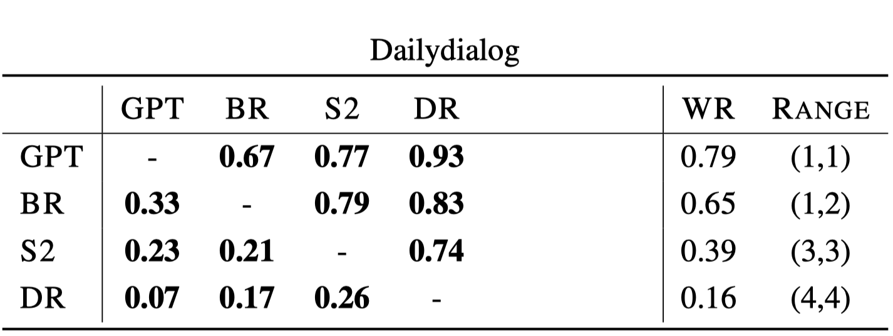
Spot The Bot (EMNLP, 2020)
Results
Ranking Results
Notes:
This table gives an overview of the win rates for each pair of bots and their ranking ranges. The bold entries denote signiﬁcance (p < 0.05) computed with Chi-square test. The ranking ranges are computed using bootstrap sampling.

Slide 17
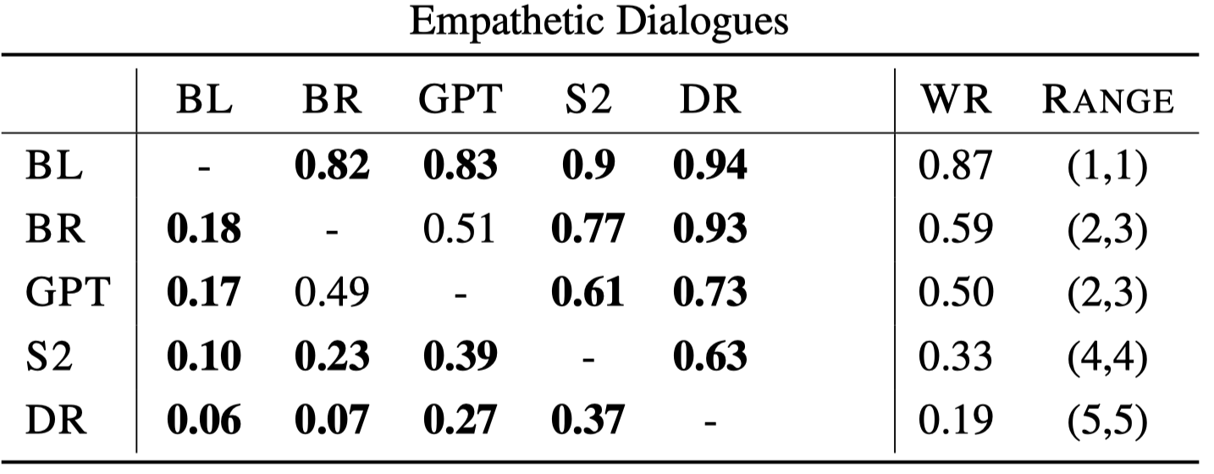
Spot The Bot (EMNLP, 2020)
Results

Slide 18
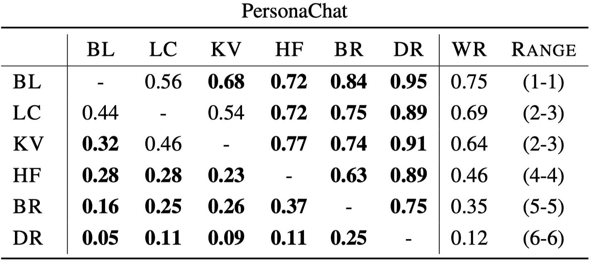
Spot The Bot (EMNLP, 2020)
Results
Notes:
As expected, DR performs worst in all three domains, which is due to its repetitive nature, which is exposed over the course of a dialogue In both domains, systems using pre-trained language models outperform the S2 model, which aligns with the expectation of related ﬁndings. The BL model outperforms all other models in both the PersonaChat and Empathetic Dialogues domains, which is in line with the results presented by the authors of the Blender model.
Furthermore, the LC model is ranked very highly. This corresponds to the ﬁndings of the ConvAI2 challenge (Dinan et al., 2020a). However, in Spot The Bot, the KV is ranked much higher than the HF model, which is not in line with the ConvAI2 evaluation.

Slide 19
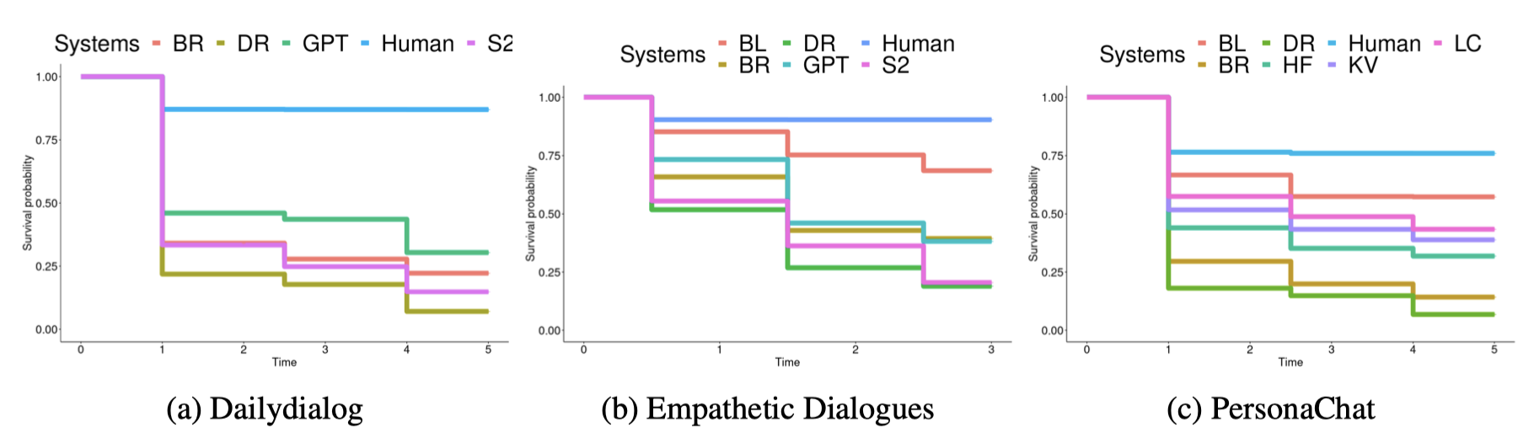
Spot The Bot (EMNLP, 2020)
Results
Survival Analysis
Notes:
This figure shows the survival functions for the three domains. The survival rates produce the same rankings as those from pairwise win rates reported in previous slides, except for the Empathetic Dialogues domain, where GPT and BR switch places. However, the distinction between these two is not signiﬁcant in any of the rankings. Further non-signiﬁcant differences within the Survival Analysis are S2 and DR in the Empathetic Dialogues domain, BR and S2 in the Dailydialog domain, and LC and KV in the PersonaChat domain.

Slide 20
Outline
Introduction
Traditional evaluation approaches
Spot The Bot (EMNLP, 2020)
Discussion

Slide 21
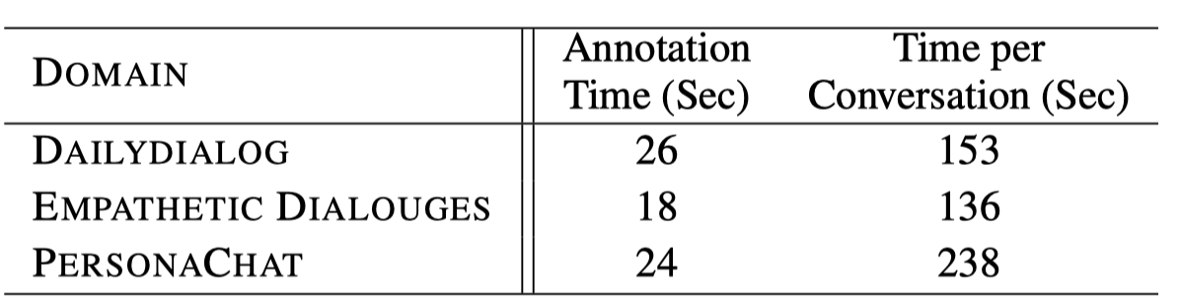
Discussion
Time efficiency
Possible direction to improve
An interactive automatic evaluation framework with high correlation with human judges.
Notes:
Time efficiency
As spot the bot is also a kind of human participated evaluation appoaches, we need to discuss its efficiency. Spot The Bot brings down the cost and time effort compared to other human participating evaluation methods.
the mean time per annotation is displayed here. For the Dailydialog and PersonaChat domain, the average annotation time is at around 25 seconds. For the Empathetic Dialogues, it is at 18 seconds, due to the shorter dialogues.
Comparing this to the time to create conversations between humans and bots which are used by traditional interactive human judgements. They recruited three dialogue system experts to interact with the systems. Each expert created 5 conversations with each system. they ignore the time needed to instruct the experts. For the Dailydialog and Empathetic Dialogues domains, it takes over 2 Minutes per conversation.
In total, they reported that spot the bot requires only 16 minutes (with 40 annotations). Thus, Spot The Bot increases the annotation speed while reducing the human raters’ mental strain.
Possible direction to improve:
Spot the bot has provided us with a good idea that we can let those evaluated chatbots to talk to each other directly.However, it still needs human participation and the length of each conversation are always quite short. While for me, looking at some of the chatlogs between chatbots, we find some simple errors like repetition and inconsistency. So maybe it’s a good way to develop just some simple rules which can score on their logs automatically and reduces the cost of time definitely. And that’s what i’m trying to do before. Maybe i’ll talk about it next time.

Slide 22
Thanks for your listening!

